Slide 1
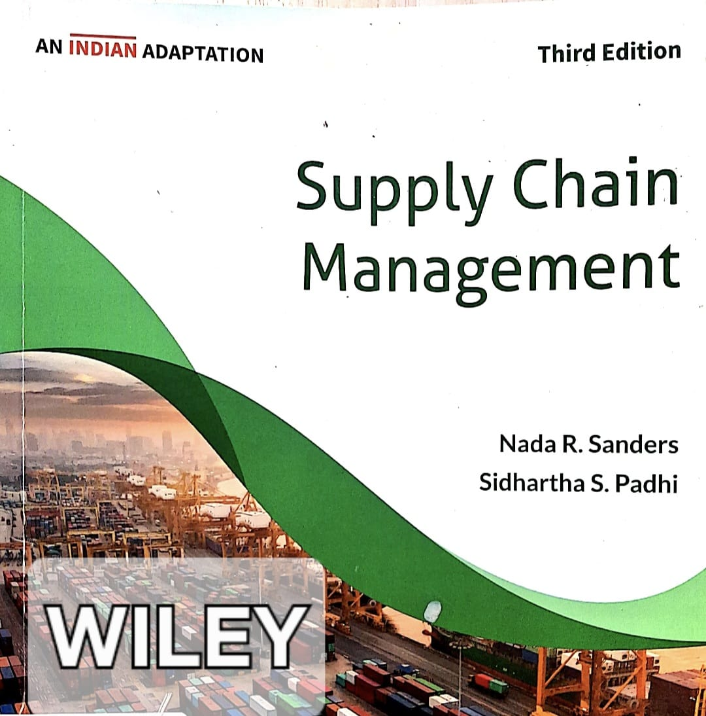
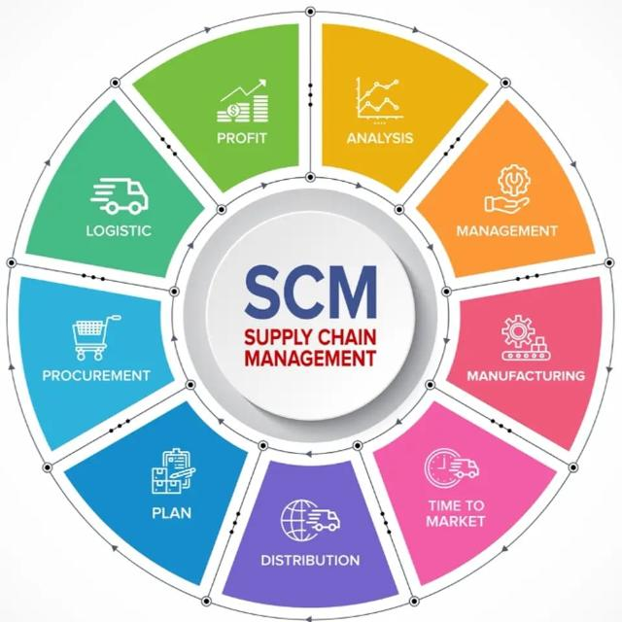

Slide 2
SUBJECT: SUPPLY CHAIN MANAGEMENT STRATEGY
CHAPTER: 02
CHAPTER TITLE: SUPPLY CHAIN STRATEGY
REFERENCE BOOK:
SUPPLY CHAIN MANAGEMENT (AN INDIAN ADAPTATION), N R SANDERS & S S PADHI, WILEY, 3RD ED. (2023)

Slide 3
KEY CONCEPTS
Business Strategy | A business strategy is a plan for the company that clearly defines the company’s long-term goals, how it plans to achieve these goals, and the way the company plans to differentiate itself from its competitors.
Supply Chain Strategy | A supply chain strategy is the plan for managing the flow of goods, information, and finances from suppliers to customers in a way that supports the business strategy.
Cost or productivity Advantage | Cost or productivity advantage exists when a firm can produce and deliver products at a lower total cost than its competitors.
Value Advantage | Value advantage exists when a company offers greater perceived value to customers than competitors.
Experience Curve | The experience curve describes the relationship between unit costs and cumulative volume, where the cost per unit of a product decreases with increased volume due to learning, efficiency improvements, and economies of scale.

Slide 4
KEY CONCEPTS
Vender-Managed Inventory (VMI) | Vendor-Managed Inventory (VMI) is a system where the supplier takes responsibility for maintaining the buyer’s inventory levels based on shared demand and stock information.
Value Segments | Value segments are identified through market segmentation and represent different customer groups that place value on different product benefits
Operation Strategy | An operations strategy involves a company's decisions regarding how it will produce goods and services and determines the design and management of manufacturing and internal processes, the use of equipment and information technology, and the specific employee skills required for production
Product Positioning Strategy | Product positioning strategy refers to the degree of product customization a firm offers which is directly related to the form in which the company stores its finished products and the length of delivery lead time it can provide to its customers

Slide 5
KEY CONCEPTS
Make-to-stock | Make-to-stock is a strategy that produces high volume finished products for immediate sale or delivery, in anticipation of demand.
Assemble-to-order | Assemble-to-order strategy, also known as built-to-order, is that strategy where the product is partially completed and kept in a generic form, then finished when an order is received.
Make-to-order | Make-to-order is a strategy for customized products or products with infrequent demand which is used to produce products to customer specifications after an order has been received.
Distribution Strategy | Distribution Strategy outlines how products reach the customer, whether through channel intermediaries (wholesalers/retailers) or direct-to-customer models like the Internet
Sourcing Strategy | Sourcing strategy, as a fundamental building block of supply chain strategy, determines which business activities a company will outsource to third-party vendors and which it will retain internally.

Slide 6
KEY CONCEPTS
Loss of Control Risk | Loss of control risk refers to the decreasing ability of a firm to control of the task or performance of the vender with the increasing scope of the task passed on to it.
Dependency Risk | Dependency risk refers to a risk that the firm will become overly dependent on the vendor when it engages the vender in more sophisticated sourcing engagements which requires specialized technology and equipment, and specialized training of staff.
Competitive Priority | Competitive priorities are the key strategic objectives, viz., cost, quality, delivery, flexibility, or innovation that a firm emphasizes to gain competitive advantage in the market.
Product Traceability | Product traceability refers to the ability to track and trace a product’s history, location, and movement throughout the entire supply chain — from raw materials to the final customer.
Order Winners | Order winners are the competitive priorities or product attributes that directly influence a customer’s purchasing decision and enable a firm to secure business over competitors.

Slide 7
KEY CONCEPTS
Order Qualifiers | Order qualifiers are the basic competitive criteria that a firm must satisfy to be considered as a viable supplier in the market.
Supply Chain Masters | Supply chain masters are organizations that achieve sustained competitive advantage by effectively integrating supply chain strategy with business strategy, resulting in superior operational, financial, and market performance.
Supply Chain Metrics | Supply chain metrics are quantitative performance indicators used to assess the efficiency, responsiveness, cost-effectiveness, and reliability of supply chain operations, enabling strategic control and continuous improvement.
Logistic Performance | Logistic performance refers to the effectiveness and efficiency with which logistics activities—such as transportation, warehousing, inventory management, and order fulfillment—are managed to ensure timely, reliable, and cost-effective delivery of products to customers

Slide 8
LECTURE 1

Slide 9
WHAT IS SUPPLY CHAIN STRATEGY?
A business strategy is a plan for the company that clearly defines
(a) the company’s long-term goals,
(b) plan to achieve these goals, and
(c) the way the company plans to differentiate itself from its competitors.
A supply chain strategy is the plan for managing the flow of goods, information, and finances from suppliers to customers in a way that supports the business strategy.
Case of Zara
Business Strategy : To produce and deliver look-alikes of the latest fashion trends to customers at an affordable price.
Supply Chain Strategy:
To be vertically integrated - giving it speed, flexibility, and control of product design and delivery.
Not to outsource most of its production, as doing so would hurt Zara’s ability to quickly adapt to fashion trends

Slide 10

WHAT IS SUPPLY CHAIN STRATEGY?
Business Strategy:
Everyday Low Price (EDLP)
Limited assortment
Focus on middle-class consumers
Supply Chain Alignment:
Own warehouses
Bulk purchasing
Limited SKUs
Low inventory variety
Minimal advertising cost
Key Differences
Aspect | Business Strategy | Supply Chain Strategy
Scope | Whole organization | Operations & logistics
Time Horizon | Long-term | Medium to long-term
Main Goal | Competitive advantage | Operational support
Level | Corporate/top management | Operations/functional

Slide 11
STRATEGIC ALLIGNMENT
Alignment means the supply chain design that supports the business strategy of the firm.
The challenge for modern businesses is to align their supply chain strategy with their overall business objectives, leveraging it as a competitive advantage rather than just a functional necessity.
A firm’s supply chain framework must be strictly aligned with its broader business goals, whether the objective is to compete on cost, time, innovation, quality, or service.
Case of an electronics company
Business strategy - to compete on delivery excellence, such as order-fulfillment time.
Supply chain strategy - speed of delivery although perhaps at a higher cost.
Change its business strategy – to compete on cost rather than delivery.
If this change in business strategy is not communicated to SCM,
the supply chain will continue to focus on delivery rather than cost
not meeting the business goals set for the company, the company will continue to excel at delivery, while incurring a higher cost.

Slide 12
ACHIEVING A COMPETITIVE ADVANTAGE
Competitive advantage is the strategic positioning that allows a firm to differentiate itself from its competitors and achieve superior marketplace success.
This can be achieved through (a) Cost or productivity advantage and (b) Value advantage
Cost or productivity advantage
Advantage derived from offering the lowest cost product or service.
A large sales volume can contribute greatly to a cost advantage.
Two factors explain reaping cost advantage from large sales volume
Economies of scale that enable the company to spread its fixed costs over a greater volume
The impact of the experience curve / Learning curve.
Learning curve - As workers gain experience with specific tasks and processes, they become more skilled and perform more efficiently.
As a company processes higher volumes, it discovers more efficient ways to manage its operations, leading to reduced organizational costs
An efficient supply chain network can increase efficiency and improve productivity, thereby reducing overall cost per unit.

Slide 13
focusing on service excellence, which is harder for competitors to replicate than technology or production practices alone. This includes shorter lead times, just-in-time deliveries, and specialized after-sales
ACHIEVING A COMPETITIVE ADVANTAGE
Value Advantage– The advantage comes from providing a product with the greatest perceived differential value compared with its competitors.
When a product is viewed as a commodity, it is typically bought on the spot market for the lowest price.
But the companies add value to the products and services which differentiate their products or services from competitors.
Ways to gain a value advantage –
Segmenting the market and identifying ‘‘value-segments’’ in the marketplace and then create a differential appeal tailored to different segments.
Auto manufacturers create different versions of the same vehicle to compete in different market segments, such as a basic two-door model versus the four-door, high-performance model
Focusing on service excellence including shorter lead times, just-in-time deliveries, and specialized after-sales support, which is harder for competitors to replicate than technology or production practices alone

Slide 14
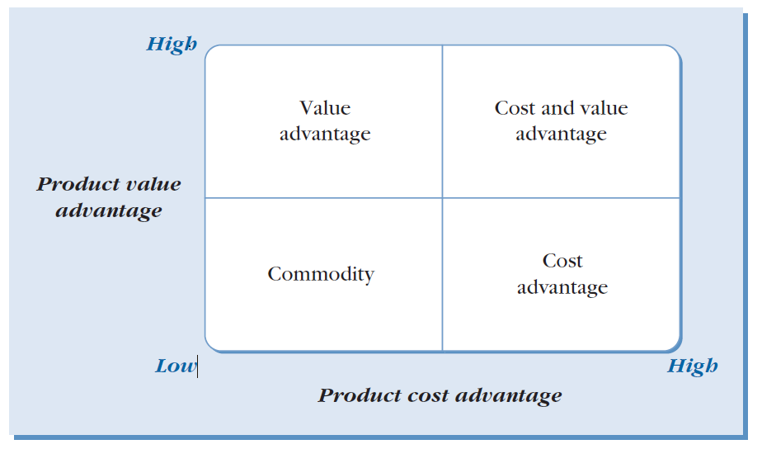
ACHIEVING A COMPETITIVE ADVANTAGE
Competitive advantage matrix:
A strategic framework used to determine a company's competitive position based on two primary dimensions, i.e., cost-productivity advantage and value advantage
Supply Chain Management (SCM) is a powerful tool for moving a company from the "commodity" quadrant toward leadership positions

Slide 15
ACHIEVING A COMPETITIVE ADVANTAGE
Four distinct competitive positions
The Commodity Position (Low Cost, Low Value) : Product is viewed as a commodity, typically bought at the lowest price on the spot market, forcing the company to compete solely on price with no unique benefits to offer.
Cost Leadership (High Cost Advantage, Low Value Advantage) - The company focuses on being the low-cost producer in its market, often associated with high sales volume
Value Leadership (Low Cost Advantage, High Value Advantage) - Companies differentiate themselves by providing products with the greatest perceived differential value compared to competitors
Cost and Value Leadership (High Cost, High Value)- Ideal position for a company where firms have successfully achieved both a cost-productivity advantage and high perceived value

Slide 16
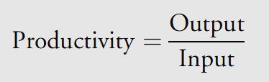
PRODUCTIVITY AS A MEASURE OF COMPETITIVENESS
One of the most common measures of competitiveness is productivity
it is calculated as a ratio of outputs (goods and services produced) to inputs (resources such as labor, materials, or capital)
Three different measures of productivity depending on the scope of what companies are evaluating
Total Productivity: Often used to assess the performance of an entire organization, warehouse, or supply chain and calculated by total output divided by the sum of labor, machines, and capital.
Partial Productivity: Focuses on a single input. For example, a company might measure labor productivity (units produced per labor hour) or machine productivity (items processed per machine hour)
Multifactor Productivity: A middle ground that measures output against several combined inputs, such as (Labor + Materials) or (Labor + Capital + Energy)

Slide 17
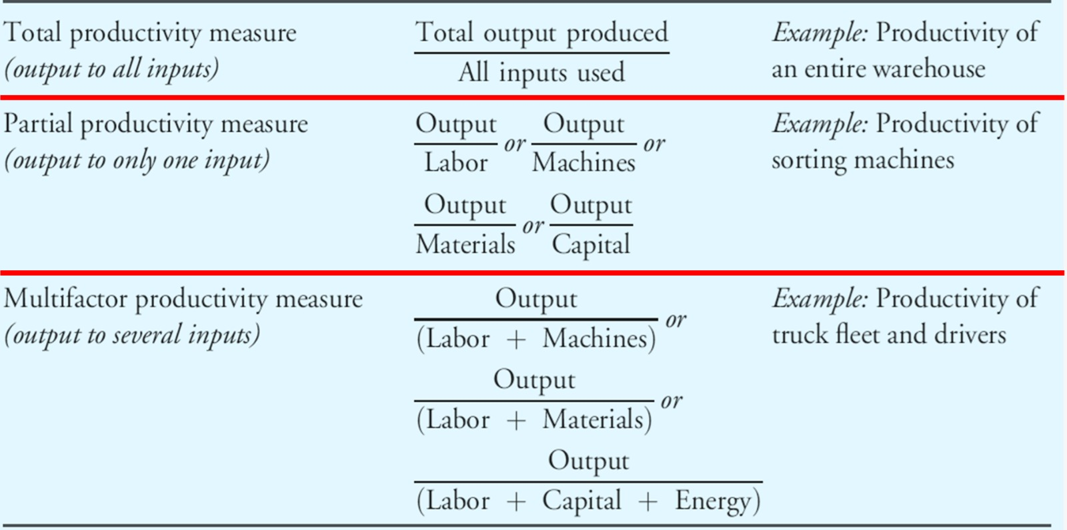
PRODUCTIVITY AS A MEASURE OF COMPETITIVENESS

Slide 18
PRODUCTIVITY AS A MEASURE OF COMPETITIVENESS
INTERPRETING PRODUCTIVITY
Compare with a Baseline (Benchmarking)
It tells us how efficiently resources are converted into output.
Higher ratio = More efficient use of resources and suggest more competitive
Lower ratio = Inefficient use of resources and suggest less competitive
Example :
The baseline measure of productivity of dry-cleaner machine is 25 garments per hour
The productivity of ‘ABC’ dry-cleaner machine is 22 garments per hour.
So, there is inefficient use of ‘ABC’ machine. The productivity of its’ competitors are higher and other brand machines are more competitive.

Slide 19
PRODUCTIVITY AS A MEASURE OF COMPETITIVENESS
B. Compare Across Time (Trend Interpretation)
Month. | 1 | 2 | 3 | 4 | 5
Productivity (in garments per hour) | 28 | 34 | 41 | 50 | 62
Productivity is more than the base line productivity of 25 garments per hour
Productivity had gone up after the purchase of the new machines
Productivity continued to grow perhaps as the workers adjust to using the new equipment

Slide 20
PRODUCTIVITY AS A MEASURE OF COMPETITIVENESS
Lovely Styles is a mid-sized apparel company competing with fast-fashion retailers. Management wants to evaluate whether its current supply chain strategy is efficient enough to compete on cost and responsiveness. The firm collected the following annual data for two years, viz., 2020 and 2022.
 | 2020 | 2022
Units produced (No of garments) | 1,20,000 | 1,40,000
Selling price per unit (Rs.) | 800 | 800
Labor cost (Rs.) | 1,80,00,000 | 1,75,00,000
Material cost (Rs.) | 3,00,00,000 | 3,20,00,000
Overhead cost (Rs.) | 1,20,00,000 | 1,10,00,000
Number of workers | 150 | 140

Slide 21
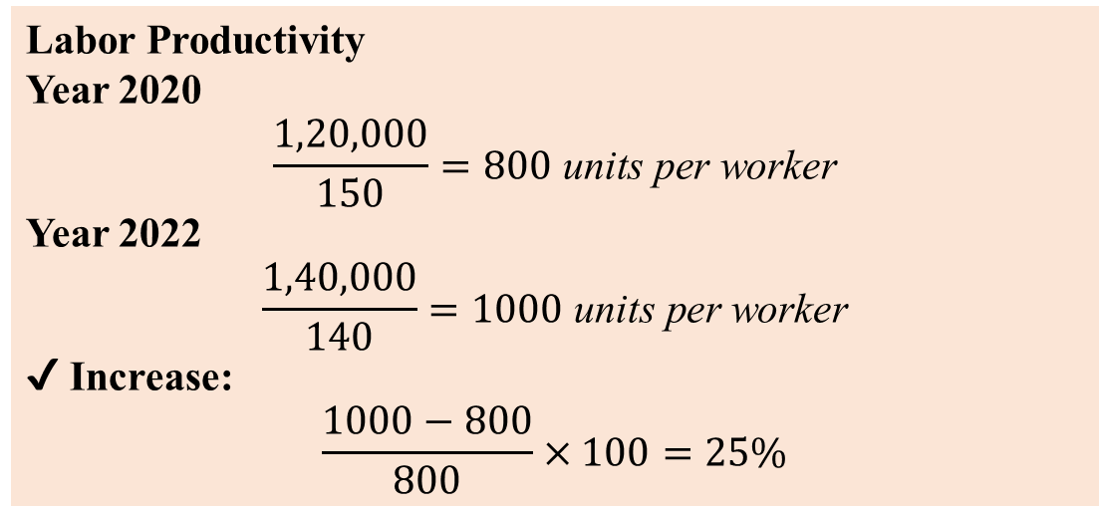
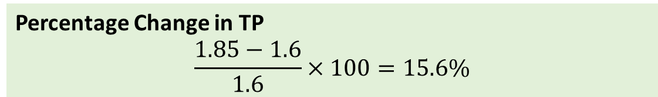
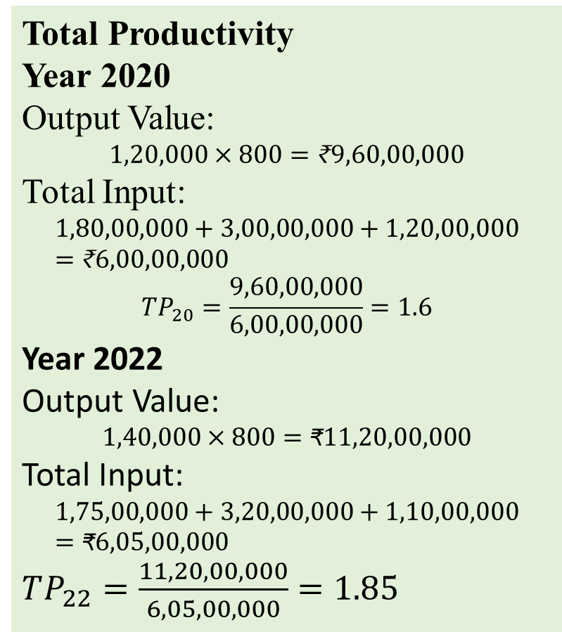
PRODUCTIVITY AS A MEASURE OF COMPETITIVENESS
Calculate, Labour Productivity, Total Productivity (TP), and percentage change in TP.
Labor Productivity
Year 2020
$$\frac{1,20,000}{150}=800 \text{units} \text{per} \text{worker}$$
Year 2022
$$\frac{1,40,000}{140}=1000 \text{units} \text{per} \text{worker}$$
✔ Increase:
$$\frac{1000−800}{800}×100=25\%$$
Total Productivity
Year 2020
Output Value:
$$1,20,000×800=\text{₹}9,60,00,000$$
Total Input:
$$1,80,00,000+3,00,00,000+1,20,00,000=\text{₹}6,00,00,000$$
$$TP_{20}=\frac{9,60,00,000}{6,00,00,000}=1.6$$
Year 2022
Output Value:
$$1,40,000×800=\text{₹}11,20,00,000$$
Total Input:
$$1,75,00,000+3,20,00,000+1,10,00,000=\text{₹}6,05,00,000$$
$TP_{22}=\frac{11,20,00,000}{6,05,00,000}=1.85$
Percentage Change in TP
$$\frac{1.85−1.6}{1.6}×100=15.6\%$$
Interpretation
✔ Labor productivity increased 25% ✔ Overall productivity increased 15.6% ✔ Output increased with only marginal increase in total input

Slide 22
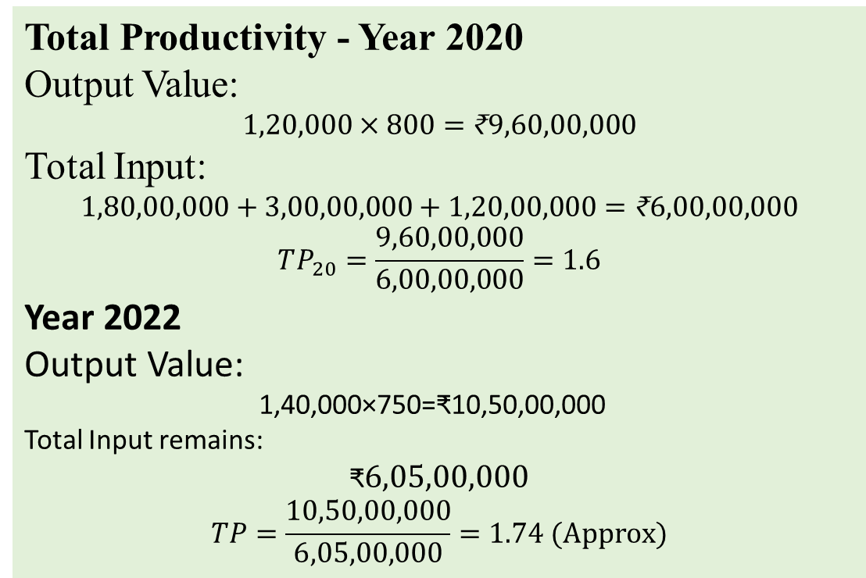
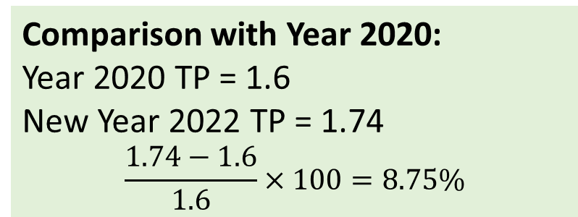
PRODUCTIVITY AS A MEASURE OF COMPETITIVENESS
Assume Year 2022 selling price dropped to ₹750 due to competitive pressure. Analyse whether total productivity improvement offsets price reduction. Should the company pursue cost leadership or differentiation strategy?
Total Productivity - Year 2020
Output Value:
$$1,20,000×800=\text{₹}9,60,00,000$$
Total Input:
$$1,80,00,000+3,00,00,000+1,20,00,000=\text{₹}6,00,00,000$$
$$TP_{20}=\frac{9,60,00,000}{6,00,00,000}=1.6$$
Year 2022
Output Value:
1,40,000×750=₹10,50,00,000
Total Input remains:
$$\text{₹}6,05,00,000$$
$$TP=\frac{10,50,00,000}{6,05,00,000}=1.74 (Approx)$$
Comparison with Year 2020:
Year 2020 TP = 1.6 New Year 2022 TP = 1.74
$$\frac{1.74−1.6}{1.6}×100=8.75\%$$
Interpretation
Productivity still improved despite price drop.
Cost leadership strategy justified.

Slide 23
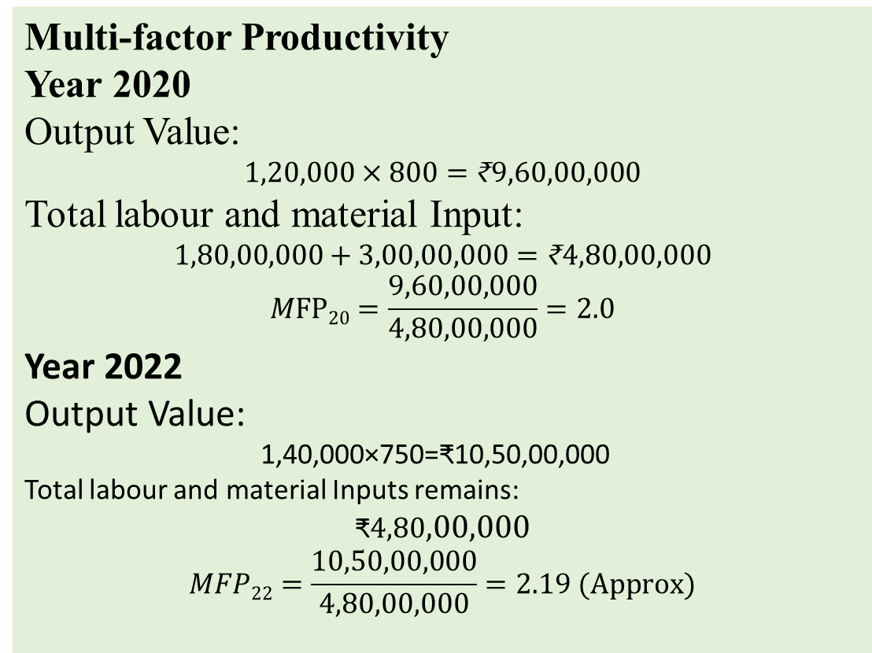
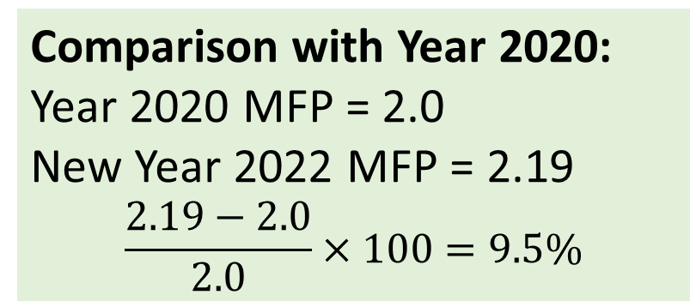
PRODUCTIVITY AS A MEASURE OF COMPETITIVENESS
3. Find Multi-factor Productivity (MFP) with respect to labour and material with selling price reduced from Rs. 800 in 2020 to Rs.750 in 2022
Multi-factor Productivity
Year 2020
Output Value:
$$1,20,000×800=\text{₹}9,60,00,000$$
Total labour and material Input:
$$1,80,00,000+3,00,00,000=\text{₹}4,80,00,000$$
$$MFP20=\frac{9,60,00,000}{4,80,00,000}=2.0$$
Year 2022
Output Value:
1,40,000×750=₹10,50,00,000
Total labour and material Inputs remains:
$$\text{₹}4,80,00,000$$
$$MFP22=\frac{10,50,00,000}{4,80,00,000}=2.19 (Approx)$$
Comparison with Year 2020:
Year 2020 MFP = 2.0 New Year 2022 MFP = 2.19
$$\frac{2.19−2.0}{2.0}×100=9.5\%$$
Interpretation
Multi-factor Productivity still improved despite price drop.
Cost leadership strategy justified.

Slide 24
ACTIVE LEARNING
Lovely Shoes is a local shoe firm competing with fast-fashion shoe firms. The firm collected the following quarterly data for 2024.
 | 1st Quarter | 2nd Quarter | 3rd Quarter | 4th Quarter
Shoes produced (No) | 5000 | 5500 | 6000 | 5500
Selling price per unit (Rs.) | 1000 | 900 | 950 | 1000
Number of labour hours used | 800 | 850 | 900 | 900
Number of machine hour used | 550 | 600 | 650 | 650
Wage rate per labour hour (Rs.) | 250 | 250 | 300 | 250
Cost per machine hour (Rs.) | 4000 | 4000 | 4000 | 4000
Calculate Labour Productivity, Machine Productivity, Total Productivity (TP), and interpret the results.

Slide 25
ACTIVE LEARNING
 | 1st Quarter | 2nd Quarter | 3rd Quarter | 4th Quarter
Shoes produced (No) | 5000 | 5500 | 6000 | 5500
Selling price per unit (Rs.) | 1000 | 900 | 950 | 1000
Number of labour hours | 800 | 850 | 900 | 900
Number of machine hour | 550 | 600 | 650 | 650
Wage rate per labour hour (Rs.) | 250 | 250 | 300 | 250
Cost per machine hour (Rs.) | 4000 | 4000 | 4000 | 4000
Value of Labour
Valur of Machine
Value of Total Input
Total Output Value
Total Productivity
Labour Productivity
Machine Productivity

Slide 26
LECTURE 2

Slide 27
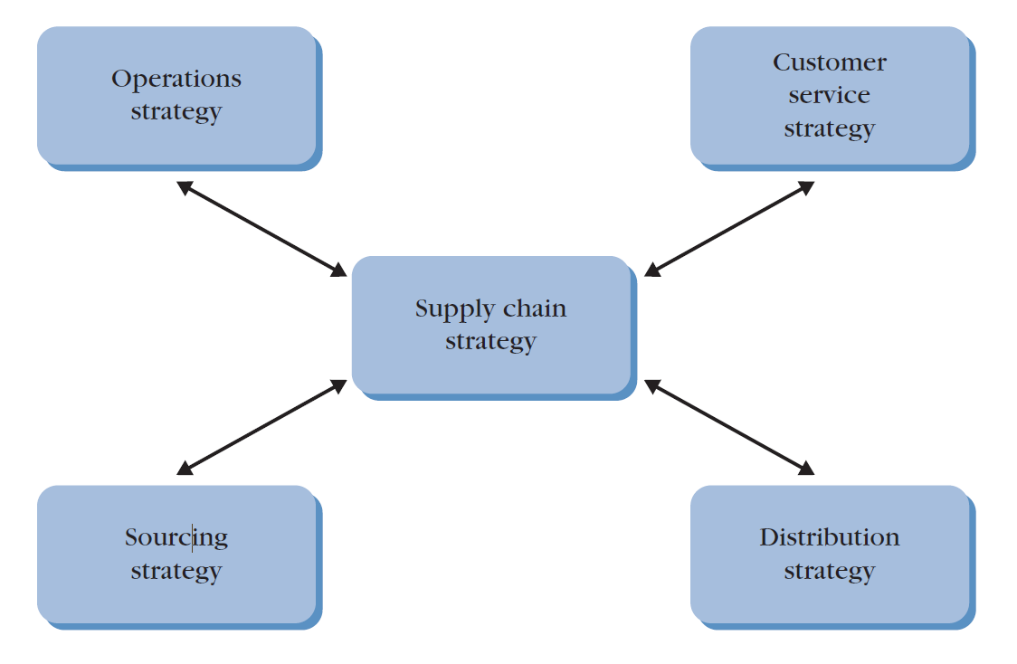
BUILDING BLOCKS OF SUPPLY CHAIN STRATEGY
The development of a supply chain strategy involves consideration of the traditional business functions and their impact (called building blocks of a supply chain strategy) on the supply chain.
Four building blocks of supply chain strategy, viz., Operations, Sourcing, Distribution, and Customer service
Organizational functions are interdependent and hence supply chain strategy is directly impacted by the decisions of the four building blocks and how they are used to support the business

Slide 28
BUILDING BLOCKS OF SUPPLY CHAIN STRATEGY
Operations Strategy
Involves decisions about how a company produces goods and services.
Determines
design and management of a company’s manufacturing and internal processes,
use of equipment, information technology and all types of employee skills needed.
Product positioning strategy –
Degree of product customization a company offers.
Directly relates to the form in which the company stores its finished products and the length of delivery lead time it can provide to its customers.
3 strategies, viz., Make-to-stock, Assemble-to-order, and Make-to-order

Slide 29
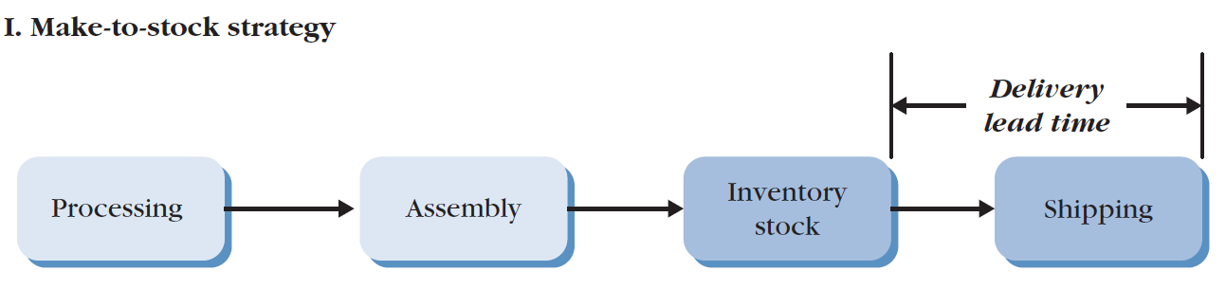
BUILDING BLOCKS OF SUPPLY CHAIN STRATEGY
Operations Strategy
(I) Make-to-stock strategy
Produces finished products for immediate sale or delivery, in anticipation of demand.
Production system is set up to produce large production batches that keep manufacturing costs down, and customer demand can be met quickly
Best strategy for standardized products that sell in high volume

Slide 30
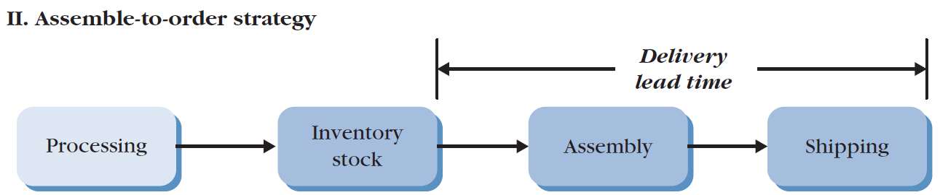
BUILDING BLOCKS OF SUPPLY CHAIN STRATEGY
Operations Strategy
(II) Assemble-to-order strategy
Product is partially completed and kept in a generic form, then finished when an order is received.
Preferred strategy when there are many variations of the end product and the company wants to achieve low finished-goods inventory and shorter customer lead times than make-to-order can deliver.

Slide 31
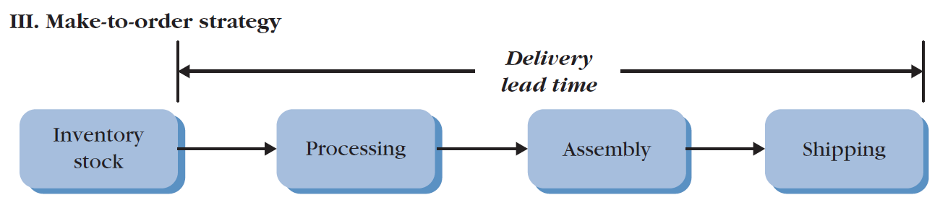
BUILDING BLOCKS OF SUPPLY CHAIN STRATEGY
Operations Strategy
(III) Make-to-order strategy
Strategy for customized products
Produce products to customer specifications after an order has been received
Preferred strategy for a wide range of product options, low product volume and longest delivery system.

Slide 32
BUILDING BLOCKS OF SUPPLY CHAIN STRATEGY
Sourcing Strategy
Sourcing involves deciding which activities to retain internally and which to outsource to third parties.
The Strategic Role of Outsourcing
Flexibility and Speed: Outsourcing allows companies to leverage a vendor's expertise and capacity, providing the flexibility to respond quickly to market changes or build new products without massive internal investment
Economies of Scale: Third-party providers often reach economies of scale in their specialized fields, allowing them to offer services or products at a lower cost than the company could achieve on its own
Technological Access: Outsourcing can provide a firm with state-of-the-art technological capability virtually overnight by tapping into the vendor's specialized resources
Strategic Outsourcing: Companies should "do what they do best and outsource the rest." Outsourcing allows firms to leverage a vendor's expertise and economies of scale.
Managing Risks: Loss of control over outcomes and dependency risk, where a firm becomes so tied to a vendor that its future strategic direction is constrained.

Slide 33
BUILDING BLOCKS OF SUPPLY CHAIN STRATEGY
Distribution Strategy
Defines the long-range plan for how a company will deliver its products and services to its customers.
Key components and strategic considerations of a distribution strategy
Channel Selection: Direct vs. Indirect
Channel Intermediaries: Selling through third parties such as distributors or retailers
Direct-to-Customer: Reaching consumer directly, often through a direct sales force or the Internet

Slide 34
BUILDING BLOCKS OF SUPPLY CHAIN STRATEGY
Distribution Strategy
Market Segmentation
Selection of distribution strategy is not a "one-size-fits-all" decision and requires market segmentation, which involves
Analyzing Perceived Value: Understanding what different customer groups value in the delivery process
Assessing Profitability and Competition: Evaluating which segments are most lucrative and how competitors serve them
Prioritizing Resources: Determining which segments should receive priority in instances of product shortages
Hybrid Distribution Models
One channel uses traditional retail distributors to reach individual shoppers in stores
A second channel uses a direct-to-customer approach for home or office delivery and replenishment
Strategic Alignment and Integration- Decisions regarding distribution must be synchronized with company’s competitive priorities (cost, time, innovation, quality, and service)

Slide 35
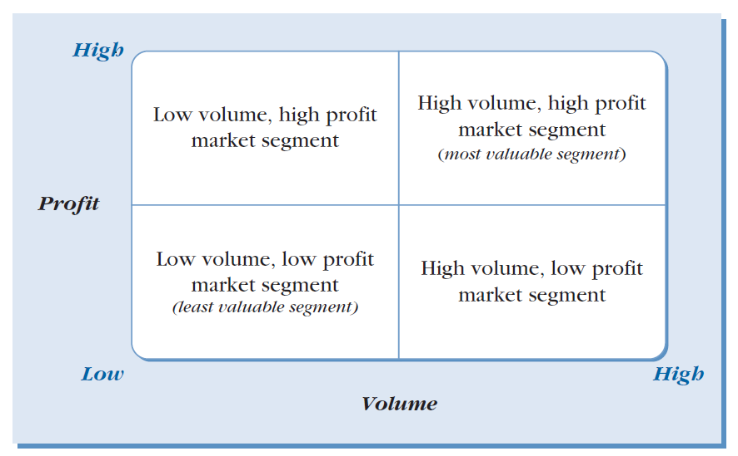
BUILDING BLOCKS OF SUPPLY CHAIN STRATEGY
Customer Service Strategy
This focuses on bringing value to the customer.
This strategy is primarily developed based on the overall volume and profitability of different market segments
To effectively manage resources, companies often divide their market into four quadrants: high volume/high profit, low volume/high profit, high volume/low profit, and low volume/low profit
Strategic priority is given to high volume and high profitability segment, as it represents the company's most valuable customers.
Market segmentation based on volume and profitability.
Not all customers require the same service; for instance, high-service levels are costly and should not be wasted on segments that do not value them.

Slide 36
LECTURE 3

Slide 37
SUPPLY CHAIN STRATEGIC DESIGN
The way a company competes in the marketplace is called a competitive priority.
Supply chain strategy and supply chain design greatly depend on a company’s competitive priorities, i.e., Cost, Time, Innovation, Quality, and Service
(A) COMPETING ON COST
Low-cost supply chain focuses on meeting efficiency-based metrics such as asset utilization, inventory days of supply, product costs, and total supply chain costs.
Dell Computer Corporation adopted a model of supply chain excellence and supplies customized products whereas Wal-Mart that promises the lowest prices but not special customized products
Although efficiency and low cost are hallmarks of excellence, they cannot be achieved at the expense of service, innovation, or quality, if one of these is an element of the business strategy.
Example –
Apparel industry, typically, outsourcing production to Southeast Asia.
The manufacturers insist on fixed production schedules to keep their costs low.
This impacts their flexibility and can hurt retailers when demands unexpectedly shift, such as when there is an unexpected surge of demand.

Slide 38
SUPPLY CHAIN STRATEGIC DESIGN
(B) COMPETING ON TIME
Companies in all industries are competing to deliver high quality products in as short a time as possible.
Example – Companies that compete on time - FedEx, LensCrafters, United Parcel Service (UPS), and Dell Computer Corporation, Zomato, Blinkit,
Dimensions of making time a competitive priority
Rapid delivery - How quickly an order is received
On time delivery - Number of times deliveries are made on time.
Companies can use technology to speed up processes or they can rely on flexible workforce to meet peak demand periods, and eliminate unnecessary steps in the production process.
FedEx - Business strategy - Compete on time
Company’s slogan is that it will ‘‘absolutely, positively’’ deliver packages on time
Used bar code technology to speed up processing and handling, and own fleet of airplanes to provide faster service

Slide 39
SUPPLY CHAIN STRATEGIC DESIGN
(C) COMPETING ON INNOVATION
This strategy requires a supply chain specifically designed to support the development and rapid delivery of "must-have" products
Innovation-focused designs prioritize flexibility, collaboration, and speed over absolute efficiency
Key elements
Focus on Speed and Product Design: Because innovative products often have a short window of opportunity before imitators enter the market, the supply chain must excel at moving from concept to market quickly
Integrated Collaboration: This strategy requires a high degree of internal integration between functional areas (like marketing and R&D) and external integration with suppliers
Premium Pricing: Because of the high financial commitment required for constant innovation, these companies typically command premium prices .
Scalability and Volume Flexibility: A major challenge for innovative supply chains is the ability to quickly ramp up production volumes if a new product becomes an overnight success

Slide 40
SUPPLY CHAIN STRATEGIC DESIGN
(D) COMPETING ON QUALITY
Company’s products and services are defined by their premium nature, specifically focusing on consistency and reliability
Example - Mercedes, General Electric, and Motorola.
Critical elements of a quality-focused supply chain design
System-Wide Quality Management-
Embedding quality into every stage of the supply chain through application of Total Quality Management (TQM) and Six Sigma
Particularly vital for perishable, fragile, or high-value luxury goods.
Product Traceability: Ability to track an item from its point of origin, through the entire chain to the customer, and back again in the case of a return.
This is important with greater emphasis on security and sustainability. Radio frequency identification (RFID) tags have provided excellent product traceability.
Specialized Sourcing and Operations - This often requires more stringent supplier selection processes to ensure that raw materials meet high standards. In terms of operations, companies may adopt "pull" systems—such as pressing oils only after an order is received—to ensure maximum freshness and potency.

Slide 41
SUPPLY CHAIN STRATEGIC DESIGN
(E) COMPETING ON SERVICE
Company focusing on understanding the specific dimensions its target customers defined as "high service" and tailors its products and processes to meet those needs.
Increasingly vital because service-based differentiation is harder for competitors to replicate than technology or product features alone.
Key elements of a service-focused supply chain design
Building Customer Loyalty: By tailoring products to meet specific needs, companies build strong customer loyalty, which often guarantees continued sales
Operational Excellence: These companies typically utilize exceptional order fulfillment systems and fast invoicing, which allow them to remain remarkably consistent and reliable

Slide 42
SUPPLY CHAIN STRATEGIC DESIGN
(E) COMPETING ON SERVICE
Key elements of a service-focused supply chain design
Targeting the "Value-Segment": Companies competing on service generally target customers who prioritize high-quality service and are willing to pay a premium for it.
Strategic Market Segmentation: A hallmark of this strategy is the ability to segment customers based on their perceived value
Cost Avoidance through Reliability: From an operational standpoint, superior service can actually lower certain costs by avoiding the expenses associated with expediting late orders or processing frequent product returns
Broad Service Scope: Differentiation through service extends beyond the physical product to include relationships, after-sales support, technical support, maintenance, and flexible financial packages

Slide 43
SUPPLY CHAIN STRATEGIC DESIGN
Competitive Priority | Supply Chain Design Focus | Example
Cost | High efficiency, asset utilization, and low-cost suppliers. | Wal-Mart
Time | Speed of delivery and reliability; elimination of non-value-added steps. | FedEx
Innovation | Speed and collaboration on product design; ability to ramp up volume quickly. | Nike / Sony
Quality | Consistency, reliability, and product traceability (e.g., using RFID). | Mercedes / Barlean’s
Service | Tailoring products to specific needs; exceptional order fulfilment. | Delta (Platinum service)

Slide 44
SUPPLY CHAIN STRATEGIC DESIGN
Trade-offs among supply chain design and adaptability
Successful strategic design requires understanding that a company cannot compete on all dimensions.
Companies need to monitor - order winners and order qualifiers.
Order winners are those characteristics that win the company orders in the marketplace.
Order qualifiers are those characteristics that will qualify the company to be a participant in a particular market.
Strategic design is a dynamic process.
Supply chains must be adaptive to respond to new technologies (like the Internet), shifts in business scope, or changes in the competitive landscape.

